Slide 1
Should sports and ESPN stay an escape?
Harrison Connelly

Slide 2
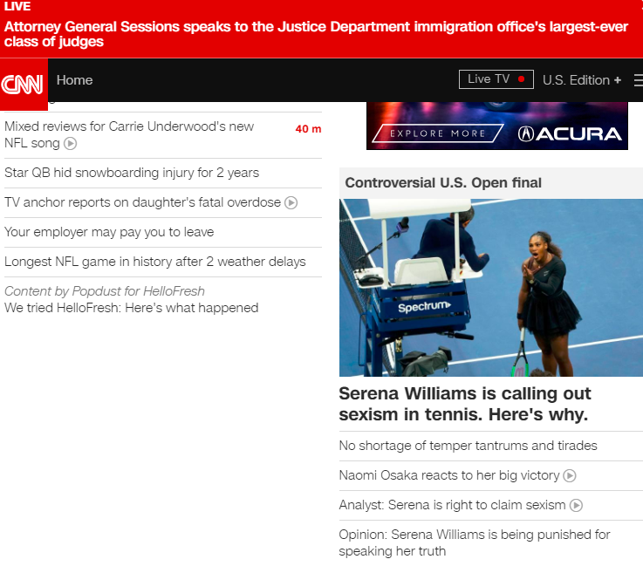

Slide 3
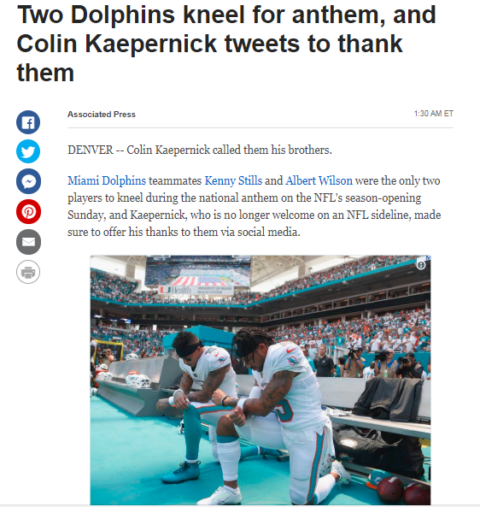

Slide 4
r/Politics
875 Samples
Dedicated to world news
Notes:
Discuss the most recent political news.
Active users discussing latest news titles.
Generally a collection of news titles and articles people are linking, not usually overall discussion
Subject does have some overlap with football as there is a major political discourse between president Trump and NFL players taking knees during National Anthem

Slide 5
r/nfl
875 Samples
Dedicated to NFL news
Notes:
Generally articles and NFL news, very little but some discussion threads
NFL overlaps because due to same reason with Knee taking Trump situation

Slide 6
Results
95% R-Squared
 | Predicted Politics | Predicted NFL
Actual Politics | 154 | 1
Actual NFL | 5 | 154
Notes:
Overtime if a given sample becomes easier or harder to tell the difference between the topic, it is a good indicator of what sports fans on reddit crave to talk about, and may also be an indicator of how sports are changing and becoming more or less political.
Also can be used by ESPN to see if a topic is something that typically falls within ESPN’s proper wheelhouse or not.
Same can be applied to CNN.

Slide 7
Use Cases
Who are you?
How much risk are you willing to take?
Can change over time tell us more information?
Notes:
Reddit NFL? Reddit Politics? CNN? NFL.com?
Determine quickly which post is to go where at scale
Determine what to name a headline appropriately
Determine what to post in appropriately
Apply to other topics
Understand difference over time, are sports getting more political or less political? Are people’s interest becoming more or less potlical? Visa-Versa.
How does this differ from CNN, ESPN and NFL.com? Are the people going to these websites different?
Can we utilize these findings to properly apply to our subreddit?

Slide 8
Thank you and Have fun!

